Slide 1
DATA STRUCTURES
Topological Ordering

Slide 2
Session Objectives
To learn topological ordering algorithm
Notes:
Student Notes:
The objective of the session is to introduce the concept of services and how these are management. There are standards and frameworks that enable the organization to manage the services. These are also introduced in this session.

Slide 3
Session Outcomes
At the end of this session, participants will be able to
Understand the ordering of vertices of the Graph using Topological sort

Slide 4
Agenda
To find the order of vertices using Topological sort

Slide 5

Topological Sorting Algorithm
Dr. B. Prabavathy
SSNCE

Slide 6
Topological sort
We have a set of tasks and a set of dependencies (precedence constraints) of form “task A must be done before task B”
Topological sort: An ordering of the tasks that conforms with the given dependencies
Goal: Find a topological sort of the tasks or decide that there is no such ordering

Slide 7
Examples
Scheduling: When scheduling task graphs in distributed systems, usually we first need to sort the tasks topologically ...and then assign them to resources (the most efficient scheduling is an NP-complete problem)
Or during compilation to order modules/libraries
d
c
a
g
f
b
e

Slide 8
Pseudocode to perform Topological Sort
void topologicalsort (graph g)
{ int counter=0, i = 0;
vertex v,w;
queue<vertex> q(num_vertex);
for each vertex v
if(indegree[v]==0)
q.enqueue(v);
while(!q.isempty()) {
v=q.dequeue();
toposort[i++]= v;
++counter;
for each w adjacent to v
if(--indegree[w]==0)
q.enqueue(w); }
if(counter!=numvertex) Error(“Graph is cyclic”);
}

Slide 9
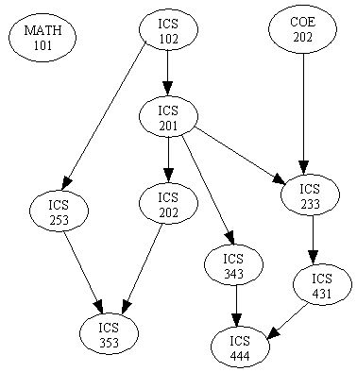
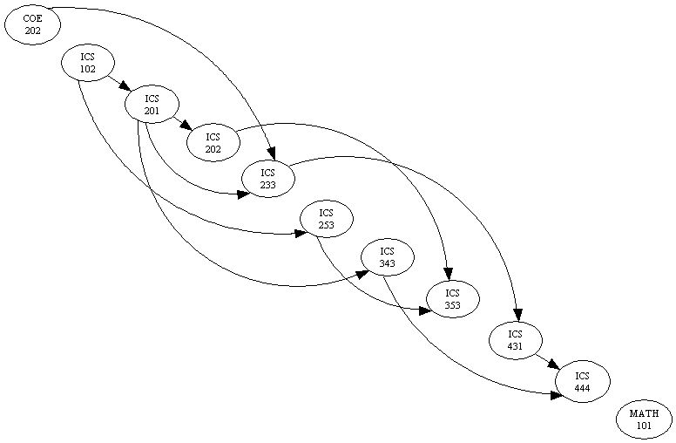
Definition of Topological Sort
Topological sort is a method of arranging the vertices in a directed acyclic graph (DAG), as a sequence, such that no vertex appear in the sequence before its predecessor.
The graph in (a) can be topologically sorted as in (b)
(a)
(b)

Slide 10
Input – Directed Acyclic Graph - G1
V1
V2
V3
V4
V5
V6
V7

Slide 11
Indegree Table for G1
Vertex | Adj. Vertices
V1 | V2,V3,V4
V2 | V4,V5
V3 | V6
V4 | V3,V6,V7
V5 | V4,V7
V6 | -
V7 | V6
Queue Q
V1
V2
V5
V4
V3
V7
V6
Indegree Table
Vertex | Init. | V1-Adj. | V2-Adj. | V5-Adj. | V4-Adj. | V3-Adj. | V7-Adj.
V1 | 0
V2 | 1 | 0
V3 | 2 | 1 |  |  | 0
V4 | 3 | 2 | 1 | 0
V5 | 1 |  | 0
V6 | 3 |  |  |  | 2 | 1 | 0
V7 | 2 |  |  | 1 | 0

Slide 12
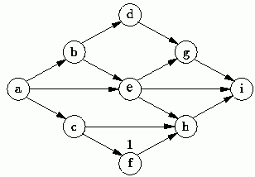
Topological Sort is not unique
Topological sort is not unique.
The following are all topological sort of the graph below:
s1 = {a, b, c, d, e, f, g, h, i}
s2 = {a, c, b, f, e, d, h, g, i}
s3 = {a, b, d, c, e, g, f, h, i}
s4 = {a, c, f, b, e, h, d, g, i}
etc.

Slide 13
Example 1-An Acyclic Graph
V₁
V₂
V₃
V₄
V₅
V₆
V₇

Slide 14
Result of applying Toposort to the graph shown in previous slide
 | Indegree Before Dequeue
Vertex | I | II | III | IV | V | VI | VII
V₁ | 0 | 0 | 0 | 0 | 0 | 0 | 0
V₂ | 1 | 0 | 0 | 0 | 0 | 0 | 0
V₃ | 2 | 1 | 1 | 0 | 0 | 0 | 0
V₄ | 2 | 1 | 0 | 0 | 0 | 0 | 0
V₅ | 2 | 2 | 1 | 0 | 0 | 0 | 0
V₆ | 3 | 3 | 3 | 2 | 1 | 1 | 0
V₇ | 2 | 2 | 2 | 1 | 1 | 0 | 0
Enqueue | V₁ | V₂ | V₄ | V_{3 ,}V₅ |  | V₇ | V₆
Dequeue | V₁ | V₂ | V₄ | V₃ | V₅ | V₇ | V₆

Slide 15
Example 2-An Acyclic Graph
V₁
V₂
V₃
V₄
V₅
V₆
V₇

Slide 16
Result of applying Toposort to the graph shown in previous slide
 | Indegree Before Dequeue
Vertex | I | II | III | IV | V | VI | VII
V₁ | 0 | 0 | 0 | 0 | 0 | 0 | 0
V₂ | 1 | 0 | 0 | 0 | 0 | 0 | 0
V₃ | 2 | 1 | 1 | 1 | 0 | 0 | 0
V₄ | 3 | 2 | 1 | 0 | 0 | 0 | 0
V₅ | 1 | 1 | 0 | 0 | 0 | 0 | 0
V₆ | 3 | 3 | 3 | 3 | 2 | 1 | 0
V₇ | 2 | 2 | 2 | 1 | 0 | 0 | 0
Enqueue | V₁ | V₂ | V₅ | V₄ | V_{3 ,}V₇ |  | V₆
Dequeue | V₁ | V₂ | V₅ | V₄ | V₃ | V₇ | V₆

Slide 17
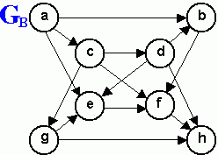
List the order in which the nodes of the directed graph G_{B} are visited by topological order traversal that starts from vertex a.
Exercise

Slide 18
Summary
Find Ordering of vertices of the Graph using Topological sort

